Slide 1



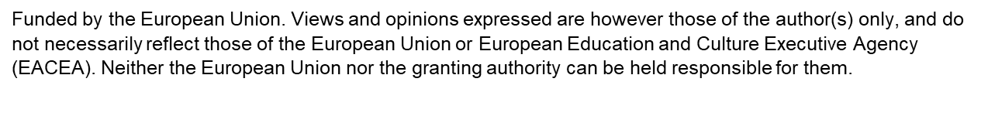
Crafting Immersive VR Scenarios for Vocational Training
A step-by-step guide for instructional designers, educators, and curriculum developers who want to harness the power of virtual reality to create compelling, effective, and scalable vocational learning experiences.
INSTRUCTIONAL DESIGN
VR EDUCATION
VOCATIONAL TRAINING

Slide 2
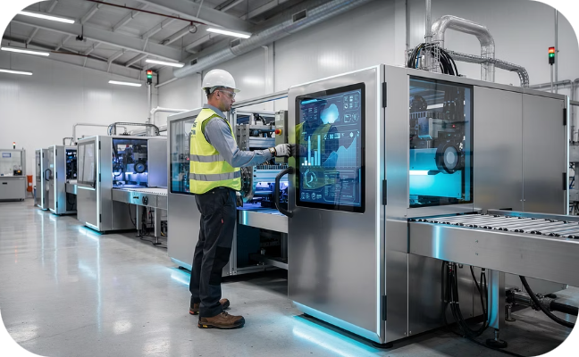
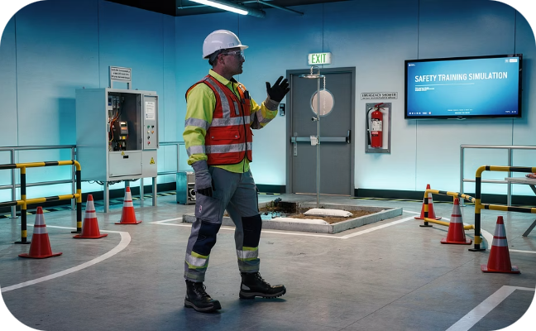
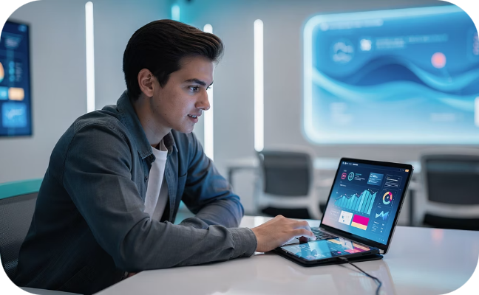

The Power of VR in Vocational Education
Virtual reality is transforming how vocational skills are taught and experienced. By placing learners inside realistic, interactive simulations, VR bridges the gap between classroom theory and real-world practice — enabling a new generation of skilled professionals to train smarter, safer, and faster.
Bridging the Experience Gap
Safe & Scalable Practice
Enhanced Engagement & Retention
Traditional vocational programs often struggle to provide sufficient hands-on exposure. VR offers highly realistic simulations that replicate workplace environments, giving learners the practical experience they need before ever setting foot on a real job site. Whether it's operating industrial equipment or conducting a clinical procedure, VR closes the gap between learning and doing.
One of VR's greatest advantages is the ability to rehearse dangerous or high-stakes tasks without real-world consequences. Learners can practice complex procedures, handle hazardous materials, or respond to emergencies repeatedly until mastery is achieved — all in a completely controlled, risk-free environment that scales effortlessly across cohorts.
Immersive environments activate multiple senses simultaneously, dramatically improving knowledge retention compared to passive learning methods like lectures or videos. Research consistently shows that experiential learning through VR leads to deeper understanding, stronger recall, and higher motivation — all critical factors in vocational skill development.
Real-World Example: NHS England's "Pharmacy: A Day in the Life" VR app provides 16–18 year olds with immersive virtual work experience inside a hospital pharmacy — enabling them to explore a healthcare career pathway before committing to it.

Slide 3

Step 1: Define Learning Objectives & Target Audience
STEP 1 OF 6
Every effective VR scenario begins long before the headset is put on. The foundation of a successful vocational VR experience is a clearly articulated set of learning objectives tied directly to the needs of a well-defined learner audience. Skipping or rushing this step is the single most common reason VR training projects fail to deliver measurable outcomes.
What Should Learners Achieve?
Who Are the Learners?
Start by asking: What specific, observable skills or knowledge should a learner demonstrate after completing this scenario? Objectives should be action-oriented and measurable. Avoid vague goals like "understand safety" — instead write "correctly identify and respond to three types of machine hazard alerts."
Understanding your audience shapes every design decision — from the complexity of interactions to the tone of narration. Gather data on age range, prior vocational knowledge, digital literacy, and preferred learning modalities before writing a single line of script.
Skills-based: Operating specific machinery, performing clinical procedures, assembling components
Knowledge-based: Recognizing safety protocols, understanding regulatory compliance
Attitudinal: Building confidence in high-pressure scenarios, developing professional judgment
Age & prior knowledge: A K-12 student needs more scaffolding than an experienced professional upskilling
Learning context: Classroom use vs. independent home use vs. workplace deployment
Accessibility needs: Motion sensitivity, visual impairments, language requirements
Example: For a manufacturing technician course, objectives might include calibrating equipment to tolerance specifications and responding correctly to a machine fault alarm.
Example: Lifeliqe's Manufacturing Technician (MT1) VR training is carefully aligned with core curriculum standards for K-12 education, ensuring age-appropriate complexity and vocabulary throughout.
Desired Outcome: Always tie objectives to a tangible result — certification readiness, improved task efficiency, reduced onboarding time, or demonstrable competency assessment scores.

Slide 4

Step 2: Scenario Design — Realism & Relevance
STEP 2 OF 6
With objectives firmly established, the next step is designing the scenario itself. The most effective vocational VR scenarios are grounded in authentic workplace situations — either a representative "day in the life" or a focused deep-dive into a single critical task. Realism is not a luxury; it is the mechanism through which transfer of learning occurs.
Choose Your Scenario Anchor
Map the User Journey & Decision Points
Build Authentic Environments & Tools
Decide whether your scenario will cover a broad slice of the workday or zoom into one high-stakes task. Broader scenarios build contextual awareness and professional identity, while focused task scenarios drive procedural mastery. The NHS Pharmacy scenario, for example, anchors around a single critical task: a pharmacy technician reviewing a patient's home medications upon hospital admission — a task with real patient safety implications.
Think of your scenario as a branching narrative. Plot out every action the learner will take, every choice they will face, and every consequence those choices might produce. A decision map (or flowchart) is an invaluable tool here. Ask: What does the user pick up, click, examine, or say? What happens if they make a mistake? What happens if they succeed on the first try? Each branch should lead to a meaningful learning moment, not a dead end.
The environment itself communicates. A realistic dialysis clinic, a fully stocked pharmacy dispensary, a live production floor — these settings signal professionalism and help learners suspend disbelief. Source reference photos, floor plans, and equipment specifications from real workplace partners where possible. Example: Lifeliqe's dialysis technician training faithfully simulates a traditional dialysis clinic, including the exact equipment a trainee would encounter on their first day at work.
Designer Tip: Involve subject matter experts (SMEs) — practicing professionals in the field — at every stage of scenario design. Their validation of realism and accuracy is what separates credible vocational VR from superficial gamification.

Slide 5

Step 3: Scripting for Interaction & Feedback
STEP 3 OF 6
A VR scenario is only as effective as its script. Unlike a film or lecture, a VR script must account for interactivity — guiding the learner through the experience, responding dynamically to their choices, and delivering feedback that reinforces the learning objectives. Writing for VR requires a blend of narrative craft, instructional design expertise, and technical awareness.
Writing Clear Instructions & Prompts
Integrating Immediate, Constructive Feedback
Instructions in VR should feel natural, not robotic. Use plain language, active voice, and second-person address ("You are now in the dispensary. Your first task is to review Rose's medication list."). Avoid information overload — introduce tasks progressively as the learner needs them. Prompts should guide without prescribing; the learner should feel agency, not feel led by the hand.
Feedback is the engine of learning in VR. Every decision point must have a clearly scripted consequence — for both correct and incorrect choices. Feedback should be:
Immediate: Delivered within seconds of the action to maintain the cognitive connection between behavior and consequence
Specific: Explain why a choice was correct or incorrect, not just that it was
Non-punitive: Frame errors as learning opportunities — "That medication combination can cause a dangerous interaction. Let's look at why..."
Escalating: First error → hint; second error → explanation; third error → guided solution
Contextual cues: Use environmental storytelling (a blinking light, an alert sound) to prompt action before text overlays
Progressive disclosure: Reveal information in layers as the learner advances through the scenario
Tone matching: Match the script's register to the professional environment — clinical, precise language for healthcare; safety-focused, direct language for manufacturing
Voiceovers & On-Screen Text
High-quality voiceover narration dramatically increases immersion. Use professional voice actors where budget allows, and ensure the script is phonetically clear for technical terminology. On-screen text overlays work well for supplementary information — dosage charts, safety specs, reference guides — that the learner might consult during a task.
Example: In a pharmacy scenario, an incorrect medication review — such as missing a contraindicated drug combination — could trigger a virtual patient alert, prompting the learner to revisit the medication chart and identify the error before proceeding.

Slide 6
Step 4: Visual Storytelling & Immersion
STEP 4 OF 6
In VR, the visual environment is the medium. Unlike a textbook diagram or a classroom demonstration, a well-crafted VR environment places the learner inside the story — making visual fidelity and sensory richness critical to learning effectiveness. This step is where instructional design meets production design, and where close collaboration with 3D artists and video producers becomes essential.
360° Video vs. 3D-Rendered Environments
Interactive 3D Models for Key Concepts
360° video captures real workplace footage with authentic detail — ideal for "day in the life" orientation scenarios or when budget and timelines are tight. 3D-rendered environments offer full interactivity and can be updated without reshooting. Many successful programs combine both: 360° video for context-setting and 3D models for hands-on interactive tasks. Example: The NHS Pharmacy VR app is a fully immersive VR360 experience capturing a real hospital pharmacy environment.
For procedural tasks — assembling equipment, operating machinery, identifying anatomical structures — interactive 3D models allow learners to manipulate objects in ways that 360° video cannot. Models can be annotated, exploded into parts, or animated to show internal mechanisms. Example: Lifeliqe integrates interactive 3D models throughout their VR courses, enabling learners to examine dialysis machine components in detail.
Intuitive UI Design Within VR
Sensory Detail & Spatial Audio
User interface elements in VR must follow different rules than screen-based design. Avoid flat 2D menus that break immersion. Instead, use diegetic UI — interfaces embedded naturally in the environment, such as a tablet on a desk, a clipboard on a wall, or a monitor displaying patient data. Keep interaction methods consistent and learnable within the first 60 seconds of the experience.
Immersion is built from details. Ambient sounds — the hum of machinery, the beep of monitors, background conversation — signal authenticity. Spatial audio, where sounds come from their correct directional source within the 3D space, dramatically increases presence. Even subtle details like correct lighting temperatures for a clinical setting versus an industrial workshop contribute to the learner's sense of being truly "there."

Slide 7
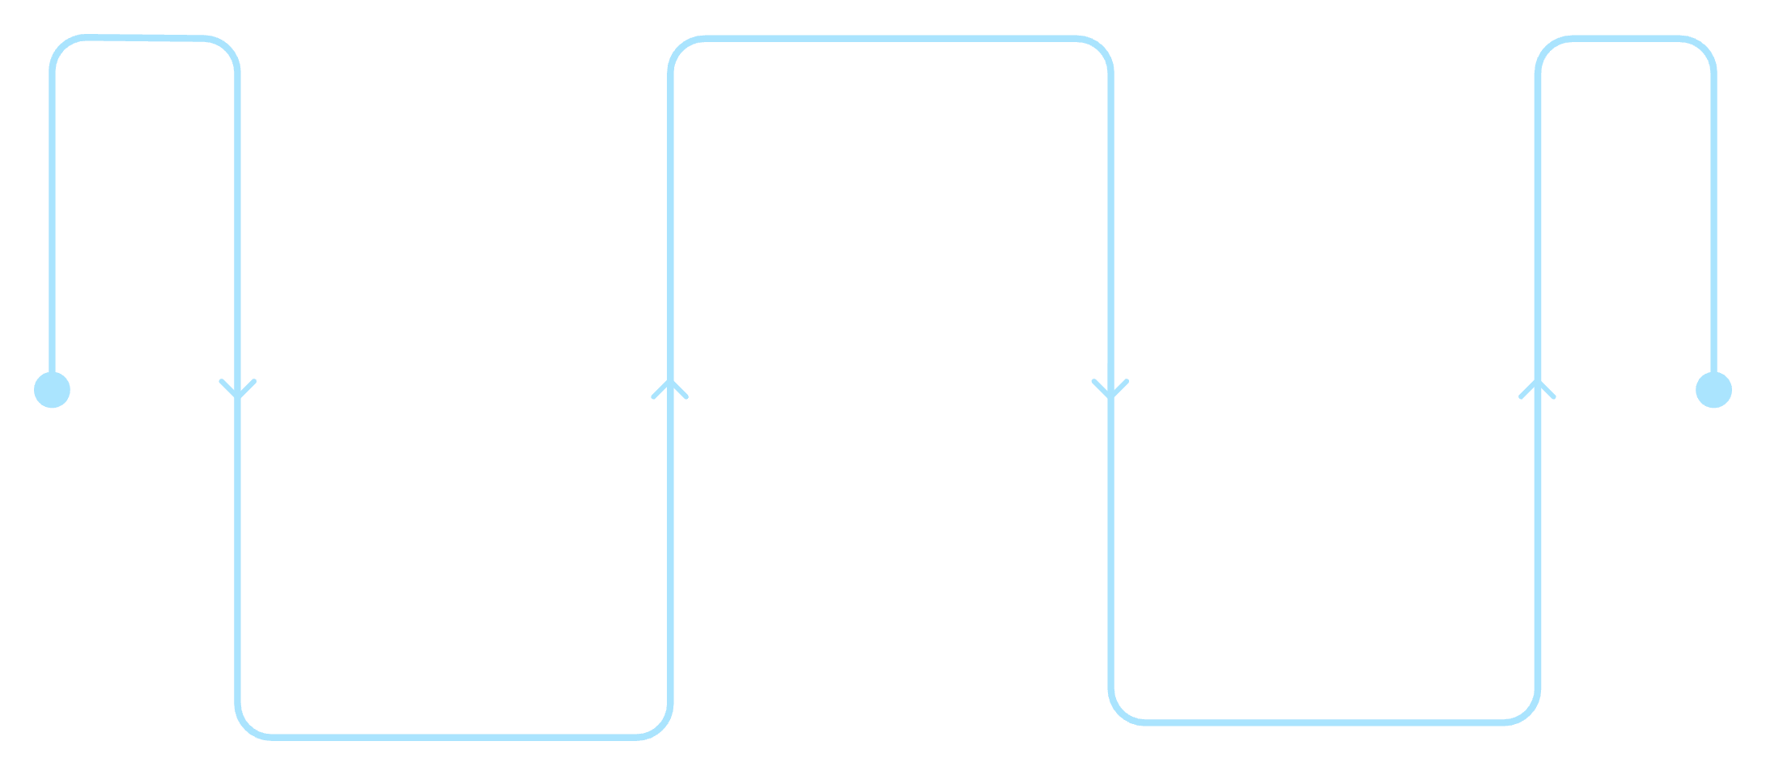
Step 5: Incorporating Challenges & Problem-Solving
STEP 5 OF 6
The defining difference between a VR experience and VR training is the presence of meaningful challenge. Passive observation — however immersive — does not build vocational competence. Learners must be placed in situations where they must think, decide, and act under realistic conditions. This step focuses on designing the cognitive load and challenge architecture that transforms VR from a novelty into a genuine learning tool.
Supported Practice
Attempt tasks with prompts
Guided Observation
Independent Performance
Watch a modeled scenario
Complete scenario unaided
The most effective VR training programs scaffold challenge progressively — moving learners from observation to supported practice to independent performance. Each stage builds confidence while increasing cognitive demand.
Realistic Complications & Unexpected Events
Designing for Critical Thinking
Real workplaces are unpredictable. Your VR scenario should be too. Introduce variables that require the learner to adapt — a patient presenting with an atypical symptom, a piece of equipment showing an error code, a colleague asking an unexpected question. These "disruptions" activate the kind of flexible, contextual thinking that rote procedure rehearsal cannot develop.
Move beyond "select the right answer" interactions. Design challenges that require the learner to investigate before deciding — checking multiple sources of information, consulting reference materials, asking virtual colleagues. The goal is active problem-solving, not pattern-matching to memorized responses.
Equipment malfunctions: A dialysis machine alarm during a routine procedure
Patient variability: A patient who is confused about their own medication history
Time pressure: An urgent request arriving while the learner is mid-task
Ethical dilemmas: A scenario where the "correct" procedural answer conflicts with a patient's stated wishes
Multi-step reasoning: Require learners to connect information from multiple sources before acting
Ambiguous situations: Not every scenario should have an obvious right answer — build in grey areas that mirror real professional judgment
Reflection prompts: After a key decision, pause the scenario and ask the learner to explain their reasoning before showing the outcome
Design Principle: The most memorable learning moments in VR are the mistakes made safely. Design challenges where intelligent failure is possible — and where the consequences of that failure are vivid, clear, and immediately educational.

Slide 8
Step 6: Technical Considerations & Deployment
STEP 6 OF 6
Even the most brilliantly designed VR scenario will fail if it cannot be reliably delivered to learners. Technical decisions made at this stage — platform, hardware, performance optimization, and accessibility — determine whether your VR training reaches its intended audience or gathers dust in a storage cupboard. Plan for deployment from day one, not as an afterthought.
Platform & Hardware Selection
Performance & User Experience
The choice of hardware fundamentally shapes what your scenario can achieve. Standalone VR headsets (e.g., Meta Quest) offer high immersion and full 3D interactivity with no PC required — ideal for dedicated training labs. Mobile-based VR (Google Cardboard-style) sacrifices fidelity for accessibility and cost. Tablet and desktop web-based experiences maximize reach but limit presence. Example: NHS training resources are available across VR headsets, mobile phones, and tablets — maximizing the number of students who can access the experience regardless of school budget.
Frame rate is not a technical detail — it is a health and safety consideration. VR experiences running below 72fps can cause motion sickness, immediately ending the learning session and creating negative associations with the training. Optimize 3D models aggressively, use level-of-detail (LOD) techniques, and test on the lowest-specification hardware your deployment scenario includes. Loading times should be minimized; learners should be in the experience within 30 seconds of launching.
Accessibility & Ease of Use
Learning Management & Data Integration
Design for the broadest possible range of users. Include subtitles for all voiceover content. Offer seated as well as standing interaction modes. Allow learners to pause, restart, or revisit any section of the scenario. For learners with motion sensitivity, provide a "comfort mode" with reduced camera movement and teleportation-based navigation instead of smooth locomotion. Onboarding tutorials should be embedded within the experience — do not assume any prior VR familiarity.
Connect your VR experience to a Learning Management System (LMS) via xAPI (Tin Can) or SCORM standards to capture granular performance data — which decisions learners made, how long they spent at each stage, how many attempts were required. This data is invaluable for both individual learner assessment and iterative scenario improvement. Ensure data storage complies with relevant privacy regulations (GDPR, FERPA, etc.) from the outset.

Slide 9

Case Study: Pharmacy Prescription Review Scenario
To bring all six steps together, this case study examines a fully realized vocational VR scenario designed to train pharmacy technicians in one of healthcare's most critical patient safety tasks: medication reconciliation on hospital admission. This scenario, inspired by NHS England's "Pharmacy: A Day in the Life" program, demonstrates how every design principle discussed in this guide can be applied in practice.
1
2
Learning Objective
The Scenario
Train pharmacy technicians to accurately review and reconcile a patient's home medications upon hospital admission — identifying potential drug interactions, dosage discrepancies, and contraindications that could compromise patient safety if left uncorrected.
The learner takes on the role of a hospital pharmacy technician. They are introduced to Rose, a newly admitted patient who has brought her home medications with her. The environment is a realistic hospital pharmacy, rendered in 360° video with interactive overlays for key tasks. Rose's medication bag contains seven different drugs from multiple prescribing physicians.
3
4
Interactions & Decisions
Feedback & Outcome
The learner must: examine each medication, cross-reference against Rose's electronic patient record, identify a potentially dangerous drug interaction between two of her prescriptions, consult the British National Formulary (BNF) reference within the VR environment, and escalate the concern to the supervising pharmacist via a virtual communication tool.
If the interaction is missed, a virtual patient alert is triggered — a dramatic but safe consequence that makes the stakes viscerally clear. Detailed explanatory feedback explains the mechanism of the interaction and its clinical implications. Upon successful completion, the learner receives a summary scorecard highlighting their decision accuracy, time efficiency, and areas for development — ready for portfolio or certification evidence.
Impact: Learners completing this scenario report significantly higher confidence in real medication reconciliation tasks, with observational assessments showing faster and more accurate performance compared to textbook-only preparation. The scenario is accessible on VR headsets, smartphones, and tablets — ensuring no learner is excluded by hardware constraints.

Slide 10



The Future of Vocational VR: Continuous Improvement
Launching a VR scenario is not the finish line — it is the starting gate. The most effective vocational VR programs treat their scenarios as living documents, continuously refined through data, feedback, and evolving technology. The organizations that will lead in VR-enabled vocational education are those that build a culture of iteration alongside a culture of innovation.
Data-Driven Iteration
Learner Feedback & Scenario Updates
Every learner interaction generates valuable data. Aggregate analytics reveal which decision points cause the most errors (suggesting unclear instructions or insufficient prior knowledge), which sections are replayed most frequently (highlighting areas of genuine difficulty or high interest), and how overall performance changes across cohorts over time. Use this data not just to assess learners, but to improve the scenario itself.
Quantitative data tells you what is happening; learner feedback tells you why. Build structured feedback collection into every session — a brief post-experience survey asking about perceived realism, difficulty, clarity of instructions, and overall confidence change. Supplement this with focus groups and think-aloud sessions where possible. Schedule regular scenario review cycles — at minimum annually, and after any significant change in the vocational standards or regulatory requirements the scenario addresses.
Heatmaps: Where do learners look and interact most within the 3D environment?
Error pattern analysis: Which wrong choices are selected most frequently, and why?
Completion rates: Where do learners disengage or abandon the scenario?
Cohort comparisons: How do outcomes differ across instructor groups, schools, or delivery formats?
AI-Driven Personalization
Multi-User & Social VR
Beyond Skills: Building Confidence
The next frontier in vocational VR is adaptive learning — scenarios that dynamically adjust their difficulty, pacing, and feedback based on individual learner performance in real time. AI-powered systems can detect when a learner is struggling and offer additional scaffolding, or increase challenge for those who are excelling — creating a truly personalized training pathway within a single scenario.
Emerging platforms allow multiple learners to inhabit the same virtual environment simultaneously — enabling team-based vocational scenarios that mirror real workplace collaboration. A surgical team, a construction crew, or a customer service team can practice together in VR, building both individual competence and collective coordination skills that single-user scenarios cannot develop.
The ultimate vision for vocational VR goes beyond procedural competence. The most transformative programs use repeated, successful VR practice to build the professional identity and psychological confidence that enables learners to walk into their first real workplace not just knowing what to do — but believing they belong there and are ready to contribute from day one.
The goal of vocational VR is not to replace the workplace — it is to make every learner's first day at work feel like their hundredth.

